Slide 1

DATA 620 Assignment 9.1 Countries Through Time
Daanish Ahmed
DATA 620 9080
Spring 2017
Professor Majed Al-Ghandour
UMUC
Image 1. World map background. Retrieved from http://www.psdgraphics.com/backgrounds/world-map-background/.

Slide 2
Introduction
Country data from United Nations Statistics Division (“UNData,” n.d.)
United States, Sweden, China, Philippines, Afghanistan
Three main variables:
Life Expectancy
Mortality Rate (Children under 5)
Gross Domestic Product (GDP)
Covers time period 1960-2015, including predictions up to 2020
Question: Is there a relationship between GDP and life expectancy/mortality rate? And how strong is it?

Slide 3
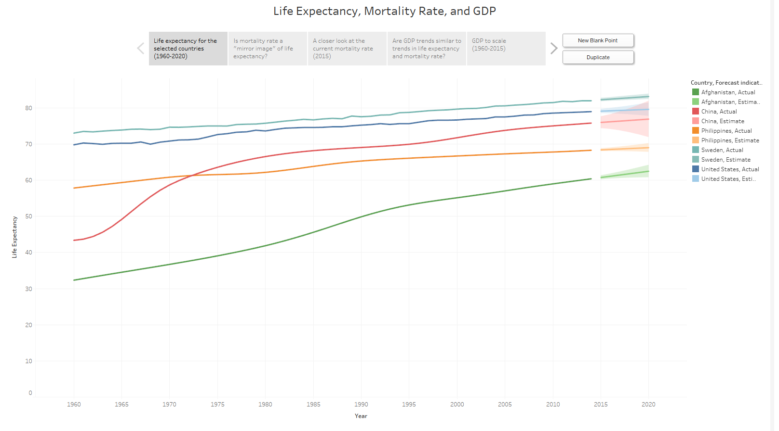
Life Expectancy
2020 Predictions (in Years):
United States: 79.57
Sweden: 83.13
China: 76.88
Philippines: 68.98
Afghanistan: 62.47
Figure 1. Life Expectancy at Birth, 1960-2020. Adapted from http://data.un.org/Data.aspx?d=WDI&f=Indicator_Code%3ASP.DYN.LE00.IN.

Slide 4
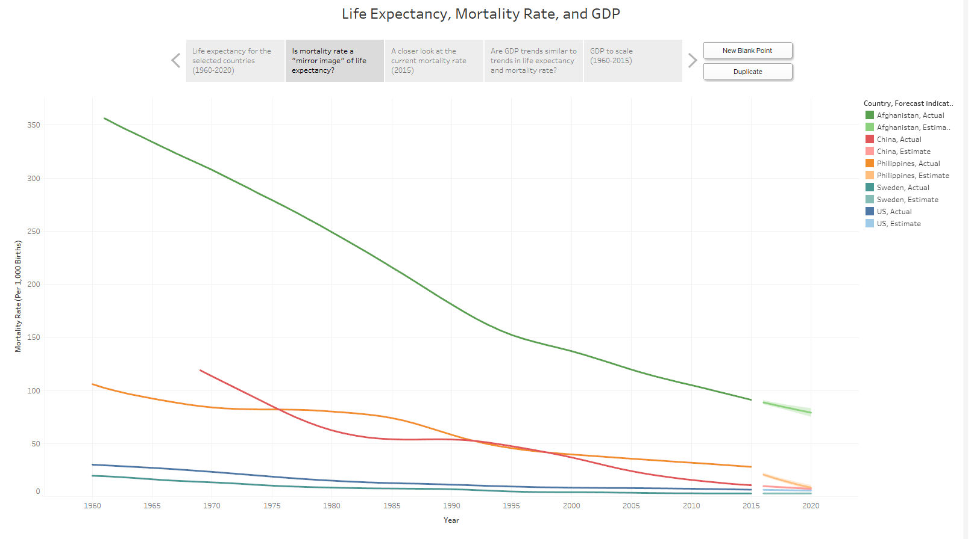
Child Mortality Rate (Under 5)
2020 Predictions:
United States: 5.7
Sweden: 3.0
China: 7.3
Philippines: 8.4
Afghanistan: 79.0
Figure 2. Child Mortality Rate (Under 5), 1960-2020. Adapted from http://data.un.org/Data.aspx?d=WDI&f=Indicator_Code%3ASH.DYN.MORT.

Slide 5
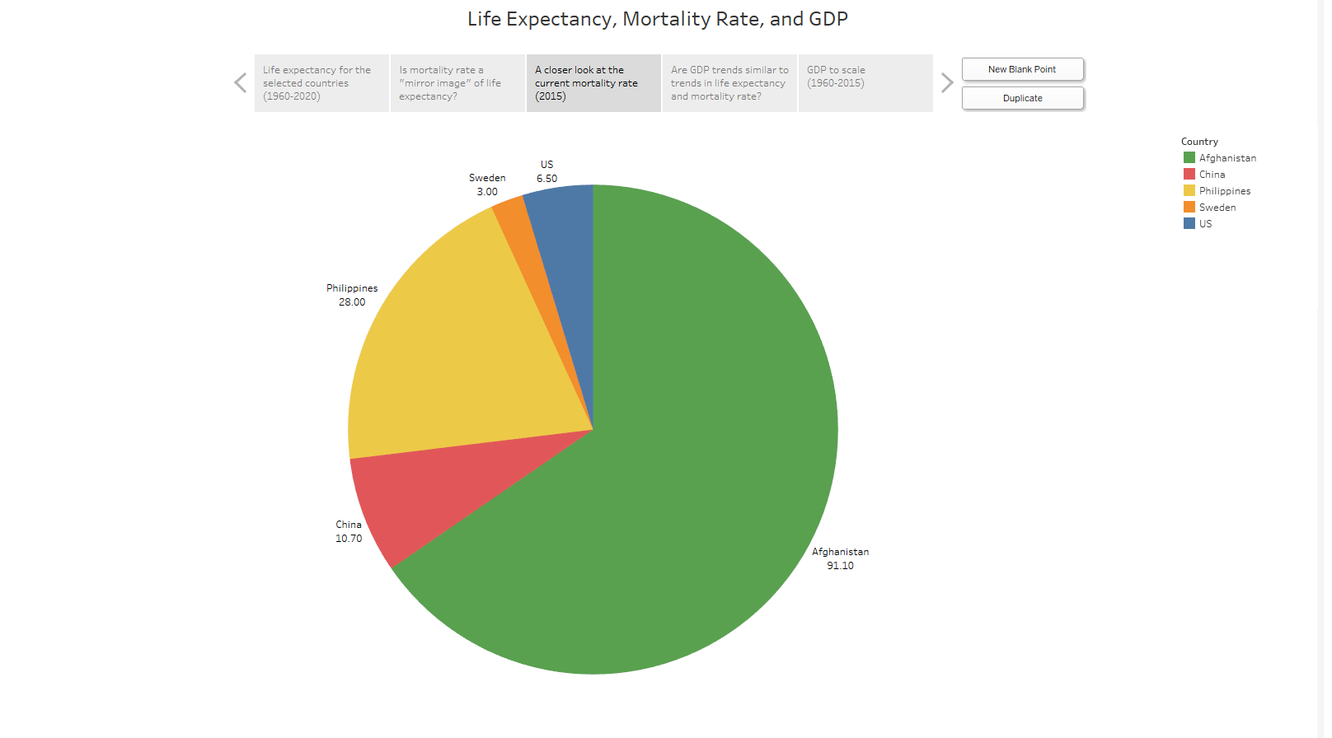
Child Mortality Rate, 2015
Figure 3. Child Mortality Rate (Under 5), 2015. Adapted from http://data.un.org/Data.aspx?d=WDI&f=Indicator_Code%3ASH.DYN.MORT.

Slide 6
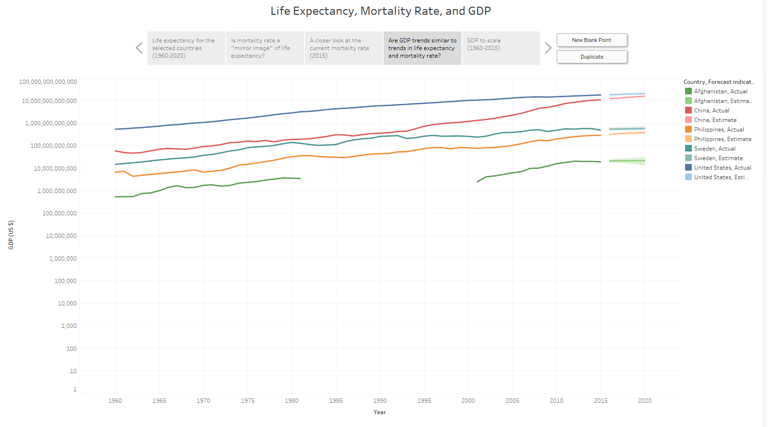
Gross Domestic Product
Afghanistan missing GDP data from 1981 to 2001, corresponding approx. with Soviet invasion and Taliban rule.
2020 Predictions (in billions of US $):
United States: 20,652
Sweden: 580
China: 15,733
Philippines: 385
Afghanistan: 22
Figure 4. Gross Domestic Product, 1960-2020. Adapted from http://data.un.org/Data.aspx?d=WDI&f=Indicator_Code%3ANY.GDP.MKTP.CD.

Slide 7
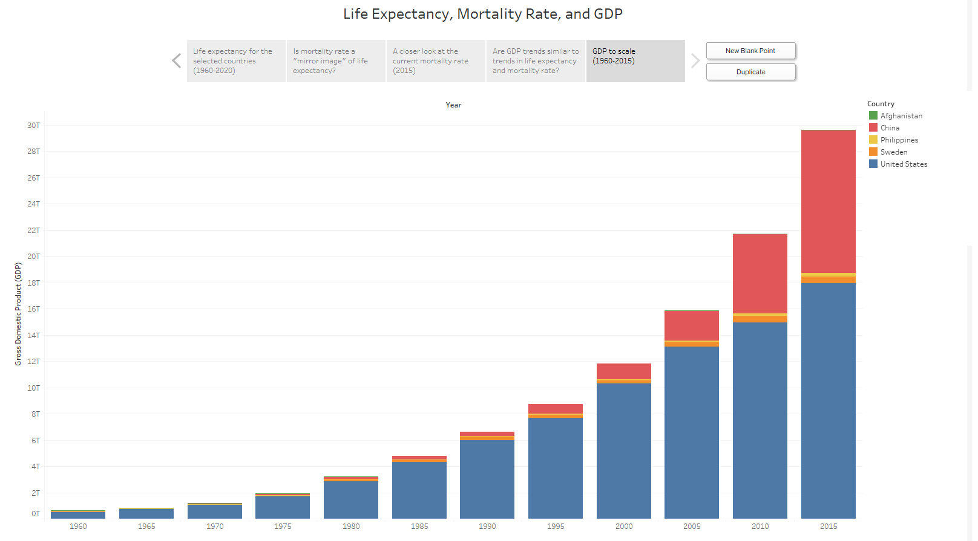
GDP, Stacked
Figure 5. Total GDP of Included Nations, 1960-2015. Adapted from http://data.un.org/Data.aspx?d=WDI&f=Indicator_Code%3ANY.GDP.MKTP.CD.

Slide 8
Prediction Accuracy (2017)
Country | Life Expectancy (Tableau) | Life Expectancy (Actual) | Mortality Rate (Tableau) | Mortality Rate (Actual) | GDP (Tableau) | GDP (Actual)
United States | 79.28 years | 79.13 years | 6.2 | 6.6 | $18,947 billion | $19,284 billion
Sweden | 82.59 years | 81.67 years | 3.0 | 3.5 | $553 billion | $530 billion
China | 76.33 years | 75.59 years | 9.1 | 16.2 | $13,017 billion | $12,263 billion
Philippines | 68.61 years | 73.27 years | 17.1 | 21.9 | $335 billion | $345 billion
Afghanistan | 61.43 years | 51.67 years | 86.2 | 161.6 | $21 billion | $17 billion
Table 1. Prediction Accuracy for Life Expectancy, Mortality Rate, and GDP. Adapted from http://www.geoba.se/population.php#country and
http://www.economywatch.com/economic-statistics/year/2017/.
Confidence in Tableau Predictions:
Life Expectancy: Medium
Mortality Rate: Very Low
GDP: Very High

Slide 9
Conclusion
Initial Question: Is there a relationship between GDP and life expectancy/mortality rate? And how strong is it?
There is a general correlation between life expectancy/mortality rate and GDP
As life expectancy or mortality rate improves, GDP tends to improve as well
However, the relationship between these variables is not as strong as initially thought.
Sweden (high life expectancy, low GDP)
China (very high GDP, higher child mortality)

Slide 10
References
2017 Economic Statistics and Indicators. (n.d.). Retrieved April 13, 2017, from http://www.economywatch.com/economic-statistics/year/2017/
Callen, T. (2012, March 28). Gross Domestic Product: An Economy’s All. Retrieved April 13, 2017, from http://www.imf.org/external/pubs/ft/fandd/basics/gdp.htm
Gazetteer Top 100 Rankings for Cities and Countries. (n.d.). Retrieved April 13, 2017, from http://www.geoba.se/population.php#country
GDP at market prices (current US$). (n.d.). Retrieved April 10, 2017, from http://data.un.org/Data.aspx?d=WDI&f=Indicator_Code%3ANY.GDP.MKTP.CD
Life expectancy at birth, total (years). (n.d.). Retrieved April 10, 2017, from http://data.un.org/Data.aspx?d=WDI&f=Indicator_Code%3ASP.DYN.LE00.IN
Mortality rate, under-5 (per 1,000). (n.d.). Retrieved April 10, 2017, from http://data.un.org/Data.aspx?d=WDI&f=Indicator_Code%3ASH.DYN.MORT
PSD Graphics. (2009, March 2). World map background [Digital image]. Retrieved April 16, 2017, from http://www.psdgraphics.com/backgrounds/world-map-background/
UNdata: explorer. (n.d.). Retrieved April 10, 2017, from http://data.un.org/Browse.aspx?d=SNA

